Slide 1
Web Development
CSE343
Lab 9

Slide 2
Express Continued

Slide 3
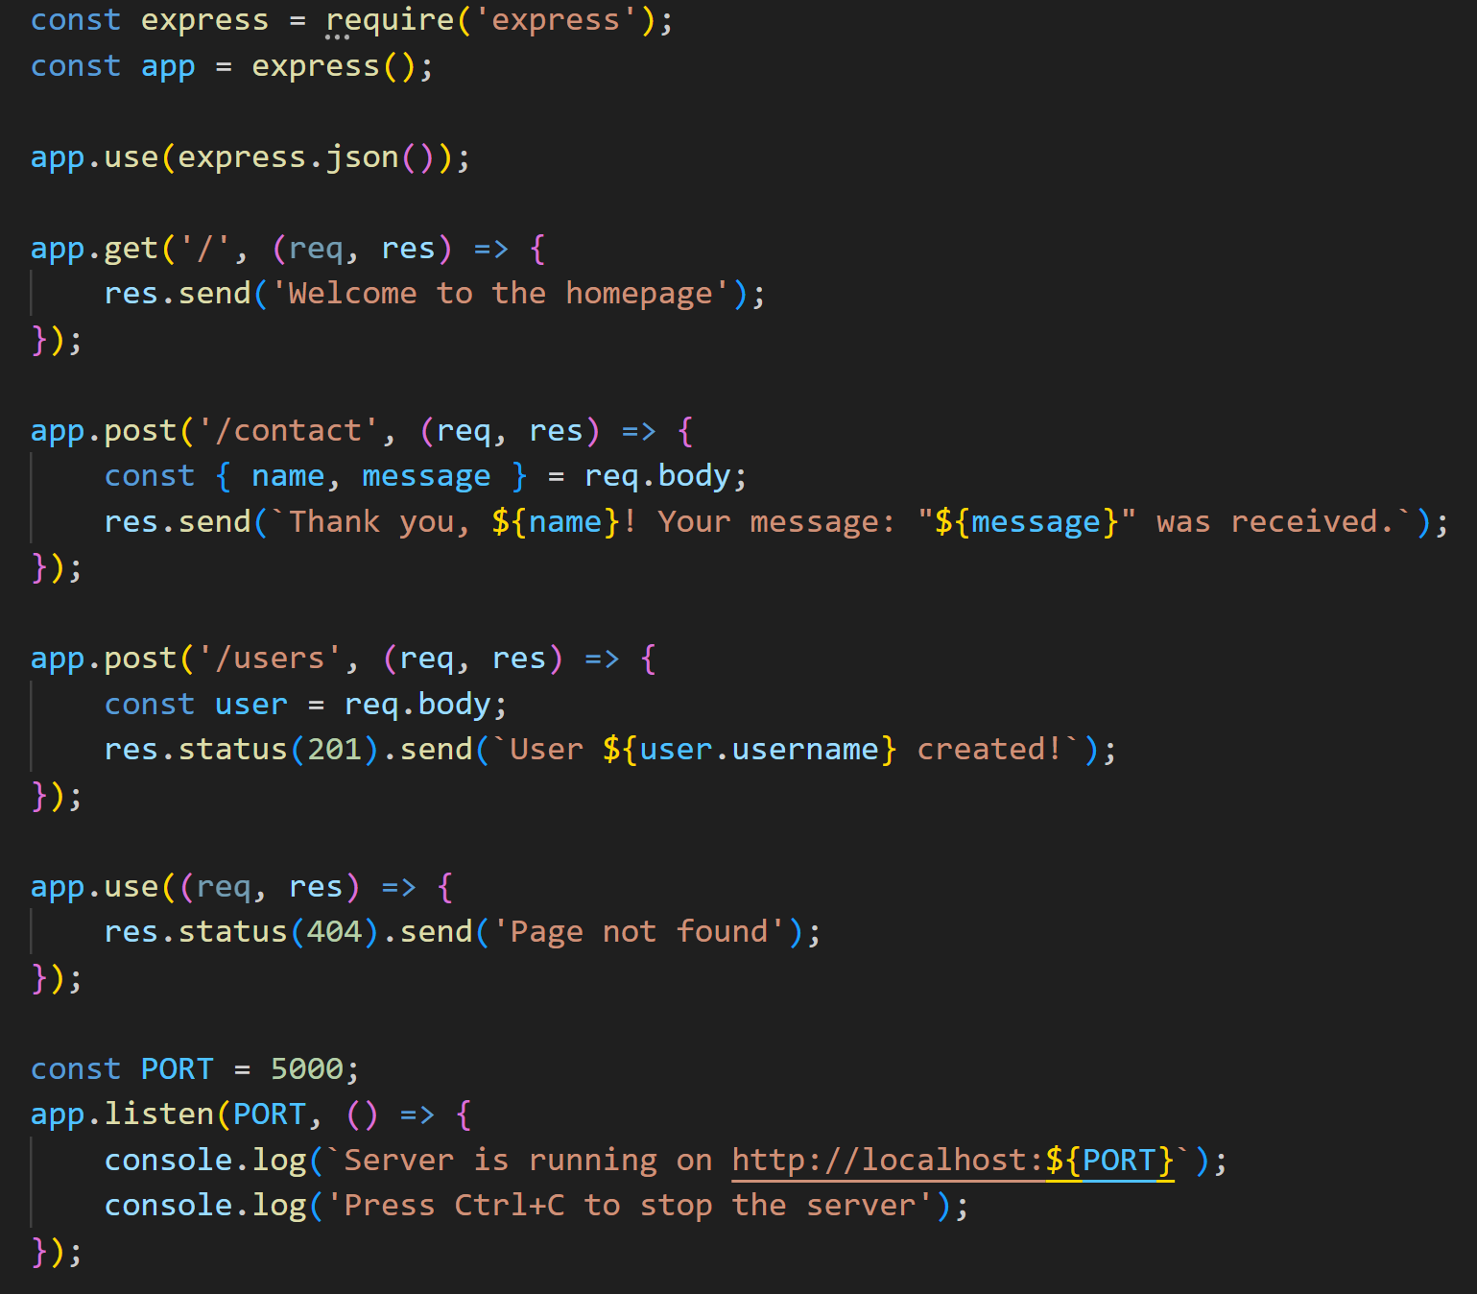
Express
Last time we looked at what is express and how to use express framework to build our server.
We also tried building a server and implementing some endpoints. Here is an example to refresh your mind a bit.

Slide 4
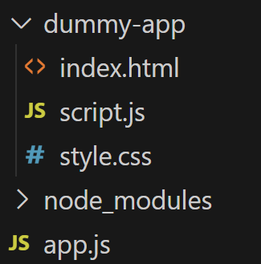
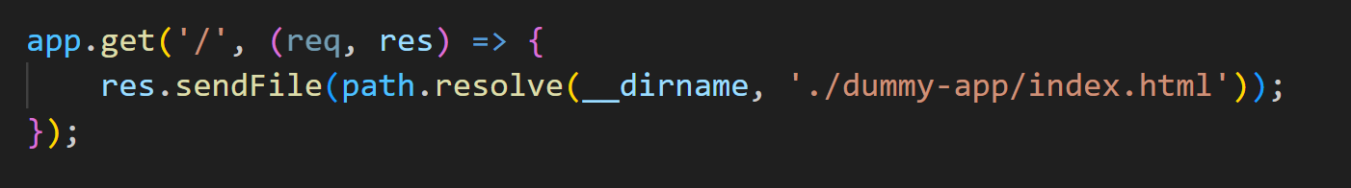
Sending back a File
What if I want to implement an endpoint that returns actually an html file instead of returning some text. To test this, I have created a dummy app as follows:
I also refactored the ‘/’ endpoint to send the index.html in the response using the path module to resolve the absolute path

Slide 5
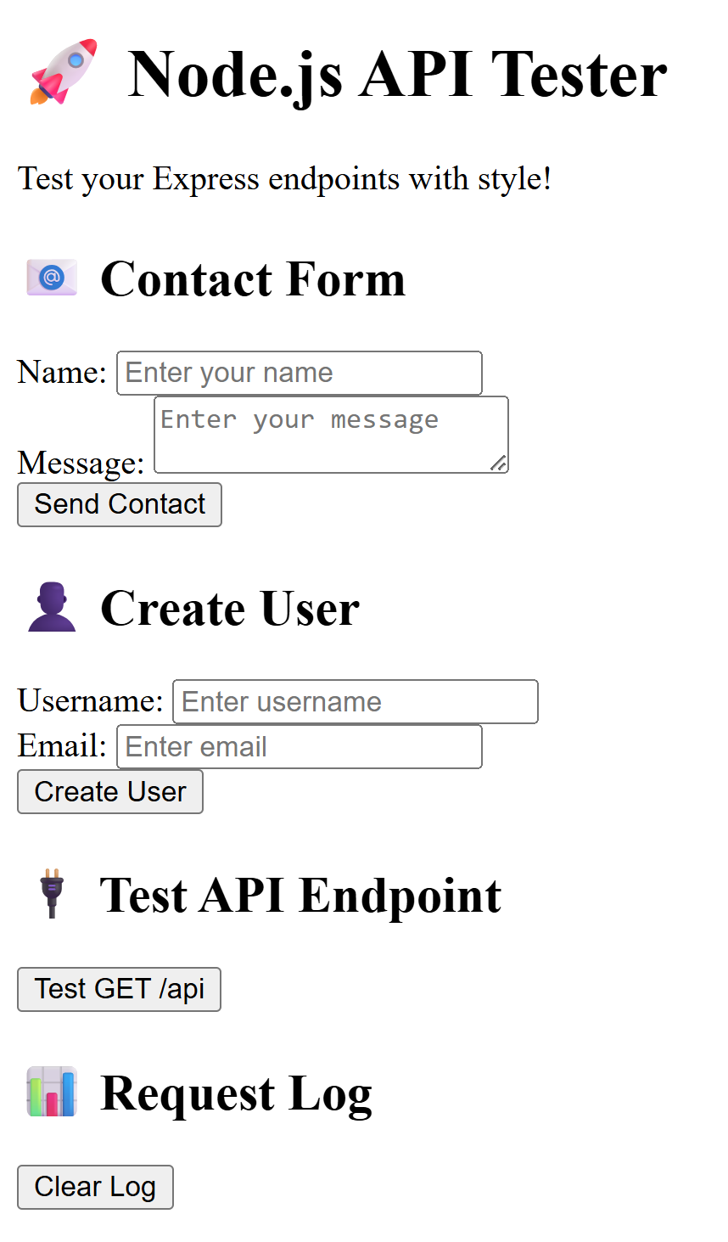
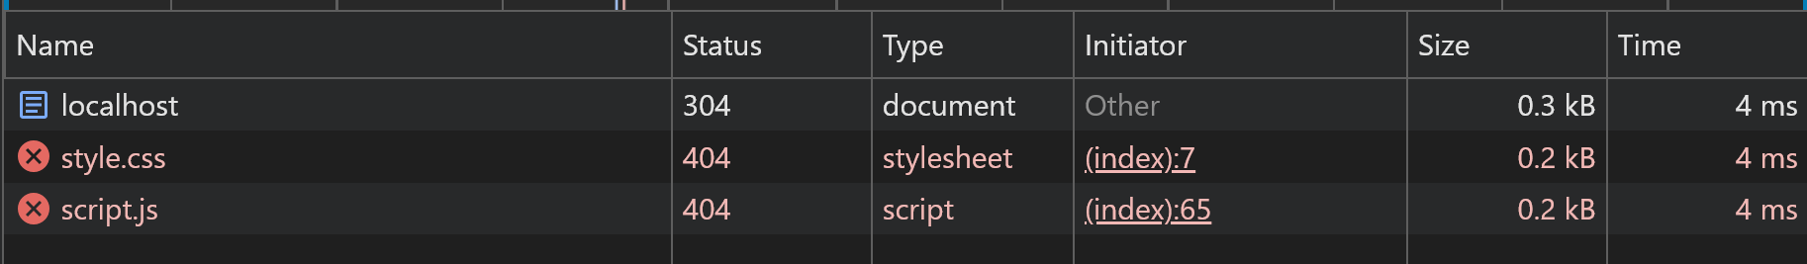
Sending back a File (cont.)
The problem is that when we try to access this endpoint, the html will be sent back correctly, but the css and js files are not sent back so the webpage will be loaded as follows:
If you take a look at the network tab in the browser you will find that the browser finds links to css and js files in the index.html file so it requests them from the backend

Slide 6
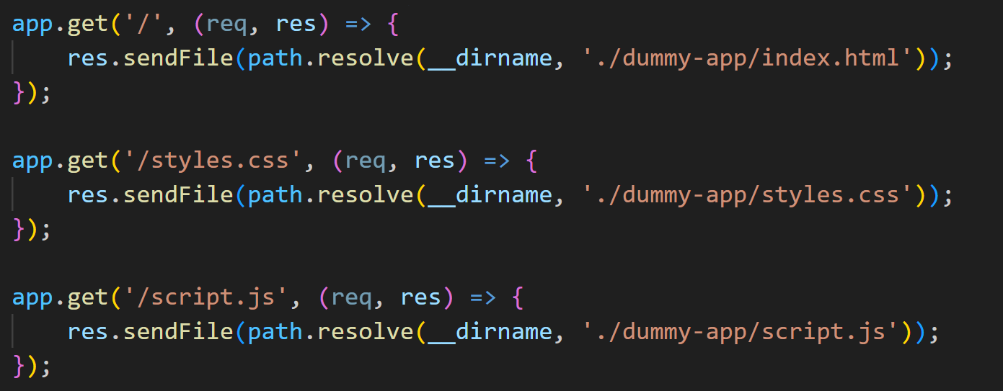
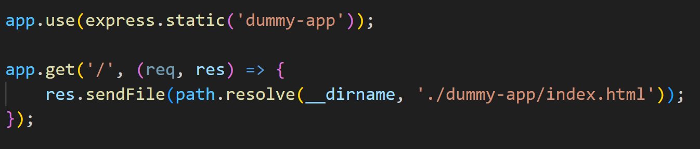
Sending back a File (cont.)
Without express you will have to create separate endpoints for that as follows:
With express, you can use the express.static function. This is middleware that serves static files 'dummy-app' is the folder name where your static files live. Express will look for files in this folder when a request comes in

Slide 7
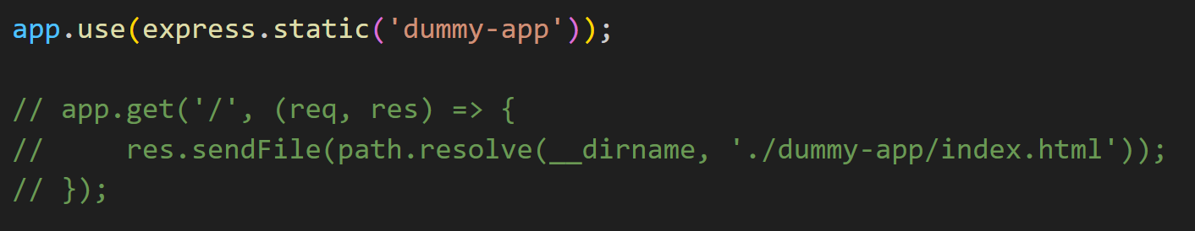
Sending back a File (cont.)
This will also work if we remove the endpoint that sends the file and keep it like:
When you use express.static(), you don't need res.sendFile() for static files anymore
Express automatically serves all files from the public folder.
Without express.static():
Browser requests: GET /
Express checks routes
Finds: app.get('/', ...)
Executes: res.sendFile('public/index.html')
Sends file to browser

Slide 8
Sending back a File (cont.)
With express.static():
Browser requests: GET /
Express checks middleware FIRST
express.static() says: "I'll handle this!"
Looks in 'public' folder
Finds index.html
Automatically sends it to browser
Never reaches your routes!
What counts as static files?
Examples include: HTML files, CSS files, JavaScript files, Images (PNG, JPG, SVG, etc.), Fonts, PDFs
You give Express a folder path, and it will automatically make all files inside that folder publicly accessible via HTTP.

Slide 9
Middleware

Slide 10
What is Middleware?
Middleware is a function that has access to:
req (request object)
res (response object)
next (function to pass control to the next middleware)
Think of middleware as checkpoints or filters that every request passes through before reaching your routes.
Each checkpoint:
Inspects you (reads req)
May modify your luggage (modifies req or res)
Decides if you can proceed (next()) or stops you (res.send())

Slide 11
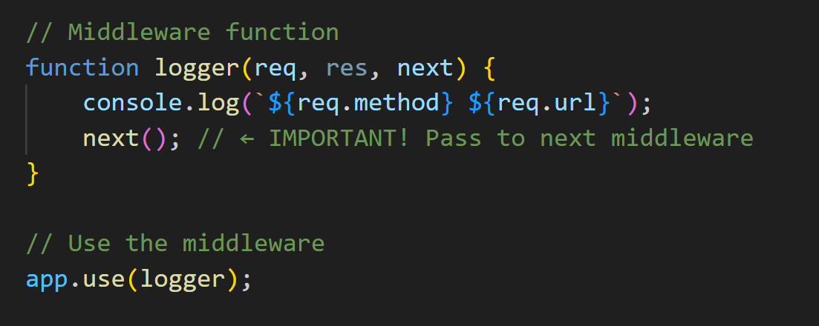
Basic Middleware structure
What happens when you visit http://localhost:5000/:
Request arrives: GET /
logger middleware runs:
Logs: "GET /"
Calls next()
Route handler runs:
Sends: "Home Page"

Slide 12
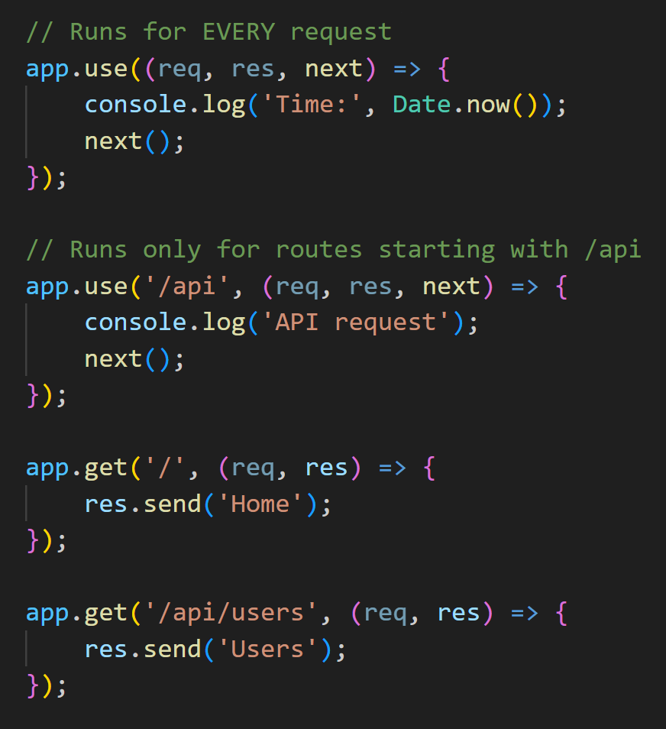
Types of Middleware
There are several types of middleware:
Application-Level Middleware -> Applies to all routes (or specific paths). Middleware that works for the entire application or specific paths.
Bound to app using app.use()
Runs for all routes (or specific paths you choose)

Slide 13
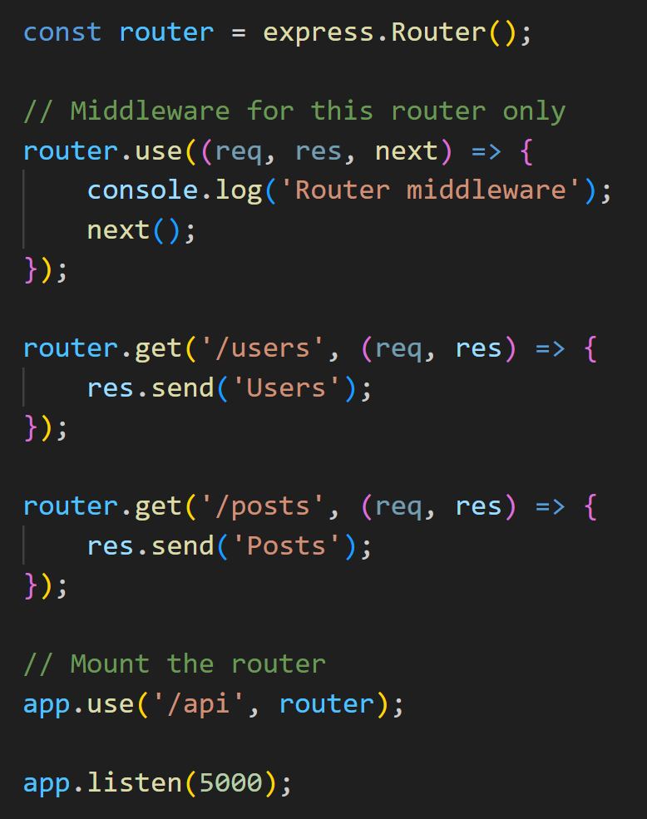
Types of Middleware
Router-Level Middleware -> Middleware that works only for a specific group of routes (a router).
Bound to router using router.use()
Only affects routes in that specific router
Helps organize large applications

Slide 14
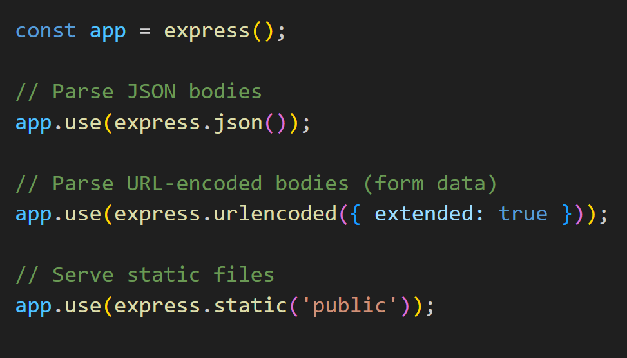
Types of Middleware
Built-in Middleware -> Middleware that comes with Express (you don't need to install anything extra).

Slide 15
Routers

Slide 16
What is a Router?
In Express, a router is a mini-application that can handle routes. It helps you organize your routes and separate them into modules instead of having all your routes in a single app.js or server.js file.
Instead of having all the routes in one file, you can have a router for /users, a router for /posts
Why Use Routers?
To Keep your code clean by splitting routes into separate files.

Slide 17
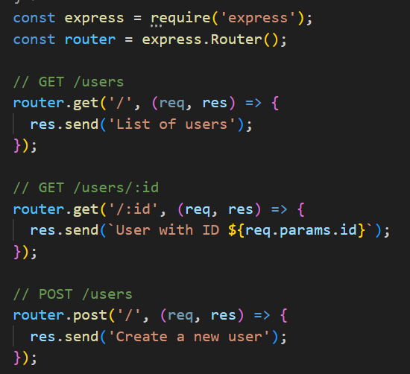
How create a router
We start by creating a separate file where you will put the specific route in.
We do not type /users, /users/:id, the router will be known for the specific route as shown.
We just create all the endpoints specific to this route

Slide 18

Exporting router
We then export our router to be used in app.js

Slide 19
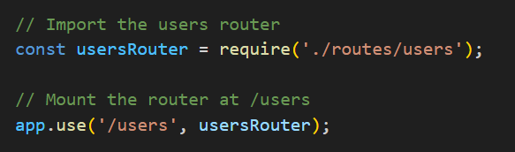
How to use router in app.js
After exporting the router in the specific routes file, we import the router in app.js and mount it using the use middleware function as follows

Slide 20
MongoDB

Slide 21
MongoDB
Until now, we have implemented endpoints that fetch data from static arrays defined directly in our code. While this approach works well for learning and small-scale applications, it comes with several critical limitations that make it unsuitable for real-world production environments.
The main problems with using static arrays are:
Data Volatility: All data stored in arrays exists only in the server's memory (RAM). This means that whenever the server restarts—whether due to a crash, deployment, or maintenance—all the data is permanently lost.
As the application grows and the number of records increases, storing everything in memory becomes impractical. Arrays must be loaded entirely into RAM, which consumes significant resources and slows down the application.
In modern applications, you often need multiple server instances running simultaneously (for load balancing or high availability). With static arrays, each server instance maintains its own separate copy of the data, leading to inconsistency. Changes made on one server aren't reflected on others.

Slide 22
MongoDB
That's why we need a database—a dedicated system designed specifically for storing, managing, and retrieving data efficiently and reliably. For this course, we will be using MongoDB, a popular NoSQL database that works exceptionally well with Node.js and Express applications.

Slide 23

What is MongoDB?
MongoDB is a document database which is often referred to as a non-relational database. This does not mean that relational data cannot be stored in document databases. It means that relational data is stored differently. A better way to refer to it is as a non-tabular database.
MongoDB is a NoSQL, document-oriented database. Instead of tables and rows (like SQL), it stores data in JSON-like documents called BSON.

Slide 24
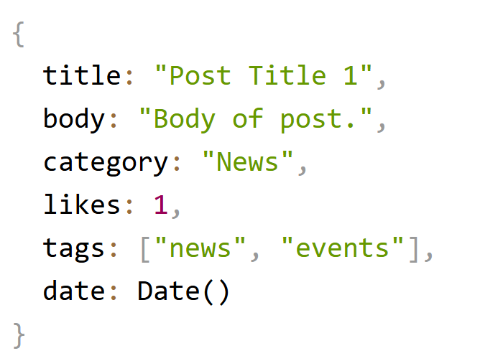
How MongoDB stores data
Records in a MongoDB database are called documents, and the field values may include numbers, strings, booleans, arrays, or even nested documents. The basic data unit in MongoDB
Looks like JSON
The following shows an example of a document:

Slide 25
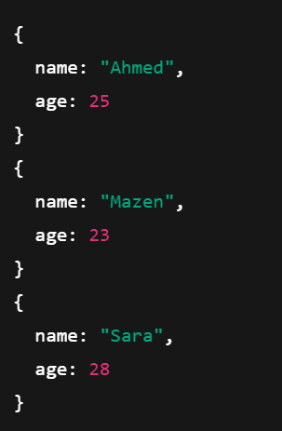
MongoDB Collections
A collection is where MongoDB stores multiple documents of the same type.
For example:
A “users” collection → stores user documents
A “posts” collection → stores post documents
A “products” collection → stores product documents
Each collection contains many documents arranged logically.

Slide 26
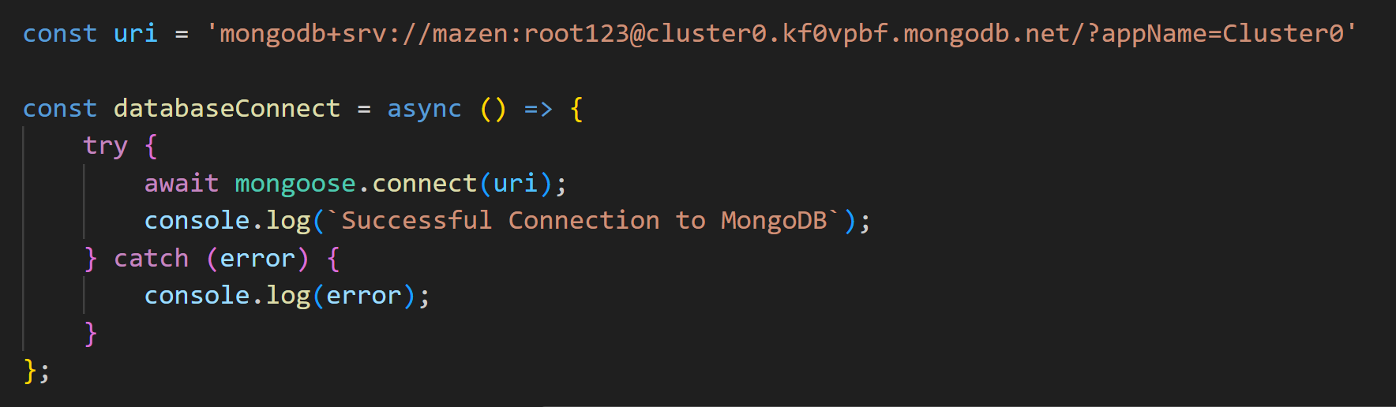
How to use MongoDB
After setting up the database in mongodb cloud platform and copying and pasting the url, we need to install mongoose package to be able to connect and interact to our mongodb database using:
Npm install mongoose

Slide 27

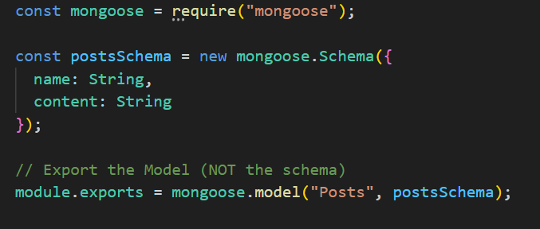
Creating a schema
A schema is a template that describes what your data should look like.
It defines:
What fields exist
What types those fields must be
Which fields are required
Default values
Validation rules
Think of it like a form template every document must follow.

Slide 28
Using the Schema in app
Now, what we need to do is import the model we created from the schema.
A model is created from a schema.
A model is what actually:
Communicates with the database
Reads data
Writes data
Deletes data
Updates data
A model represents a MongoDB collection.

Slide 29
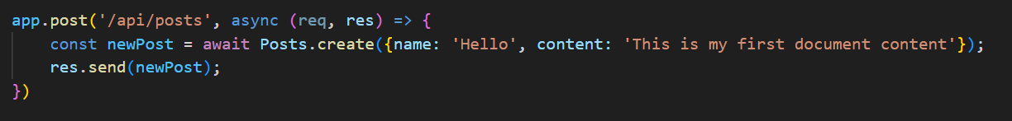
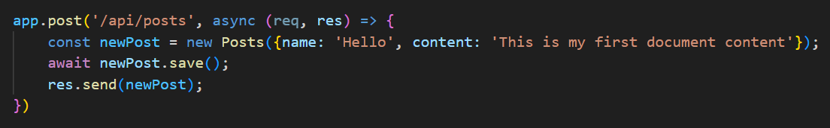
CREATE Operation
Now, let’s see how we will use the model to perform crud operations
CREATE
This is done using the Model.create(data) function. This function creates and inserts a new document.
You can also use the new Model(data) + .save() functions.
The following example shows you how to do it

Slide 30
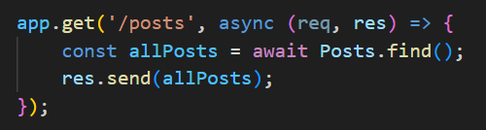
READ Operation
READ
This is done using the Post.find(). This function gets all the documents.
You can also use the new Post.find(filter) function to find a specific document.
The following example shows you how to do it

Slide 31
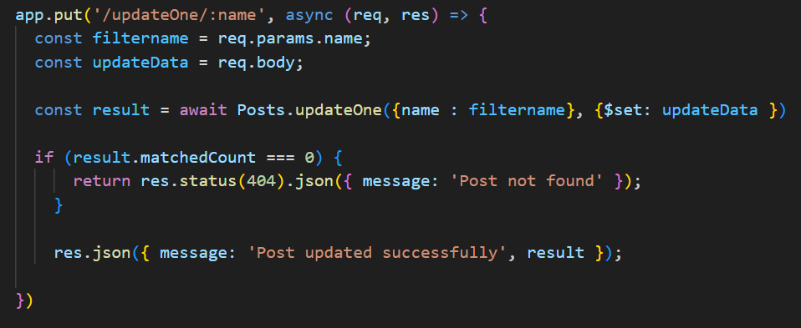
UPDATE Operation
UPDATE
This is done using the Model.updateOne(filter, update). This function updates the first document that matches the filter, but does NOT return the updated document.
You can also use the new Model.updateMany(filter, update) function Updates ALL documents matching the filter but does NOT return updated documents.
The following example shows you how to do it

Slide 32
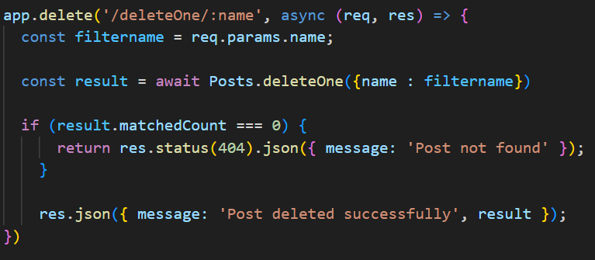
DELETE Operation
DELETE
This is done using the Model.deleteOne(). This function Deletes the first matching document but does NOT return the deleted document.
You can also use the new Model.deleteMany() function to delete all documents matching the filter, but does NOT return deleted docs.
The following example shows you how to do it

Slide 33
Lab Task

Slide 34
Lab Task (Building a Course Management API (Udemy-Style) Using Express.js, MongoDB & Routers
Create a Database Schema called Courses
Your task is to build the backend for managing courses.
Each course should include:
Title
Description
Instructor name
Price
Category (e.g., Web Development, Design, Marketing)
Number of enrolled students (default = 0)

Slide 35
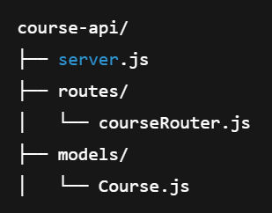
Lab Task (Building a Course Management API (Udemy-Style) Using Express.js, MongoDB & Routers
Students must:
Build an Express server.
Use Mongoose to interact with MongoDB.
Separate route logic using Express Router.
Implement CRUD operations for courses.
Test all endpoints with sample data.

